Slide 1
Structure of a Mid-Latitude Cyclone

Slide 2
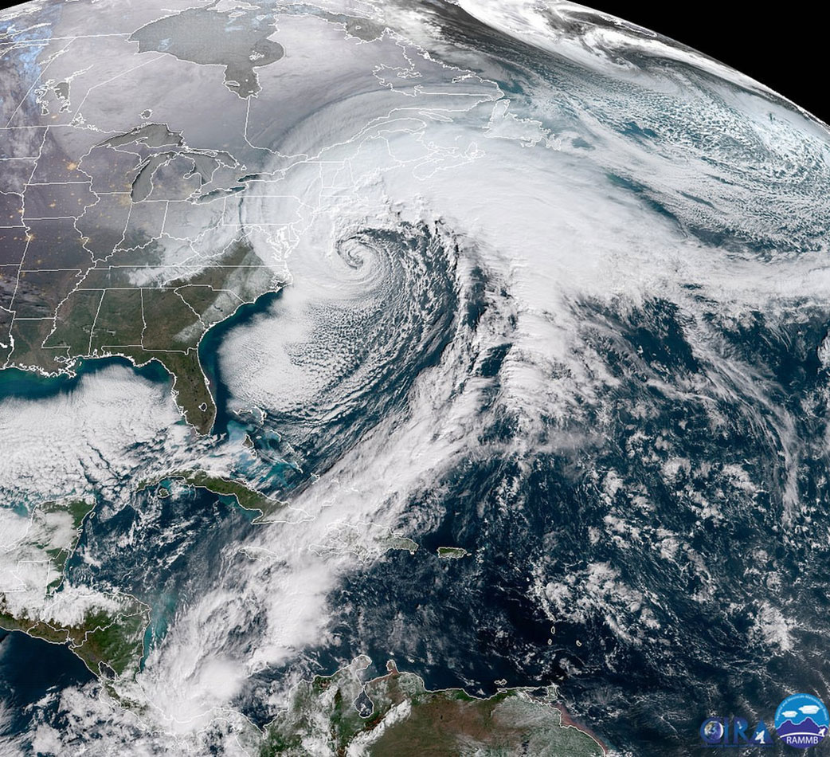
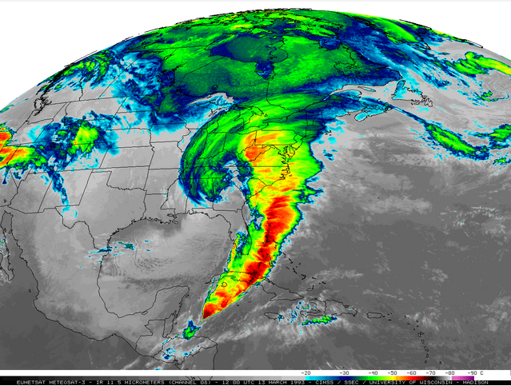
Horizontal Structure
From above, a mature mid-latitude cyclone is generally shaped like a giant “comma”, formed by clouds along the warm and cold fronts and within the central low pressure.

Slide 3
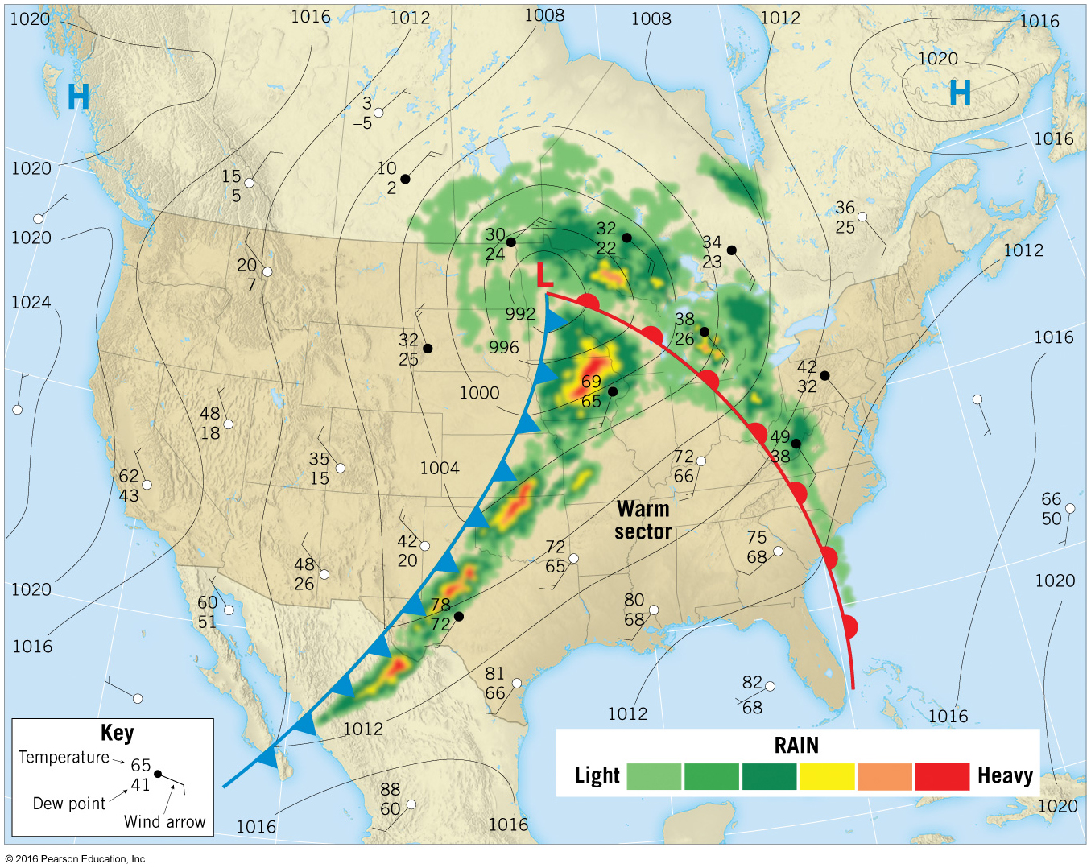
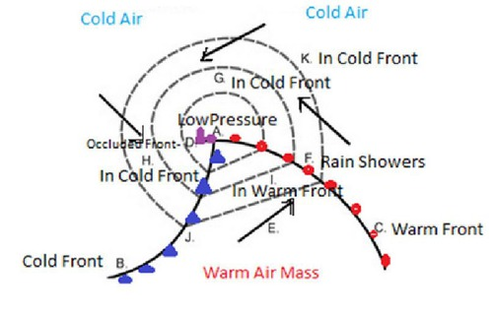
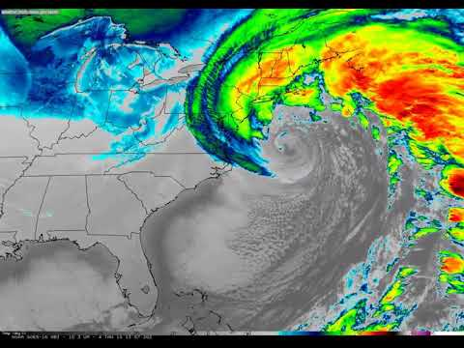
Cloud and Precipitation Patterns
Depending on the stage of the cyclone, precipitation and cloud patterns can vary; however, the type and distribution of both can be predicted by meteorologists.

Slide 4
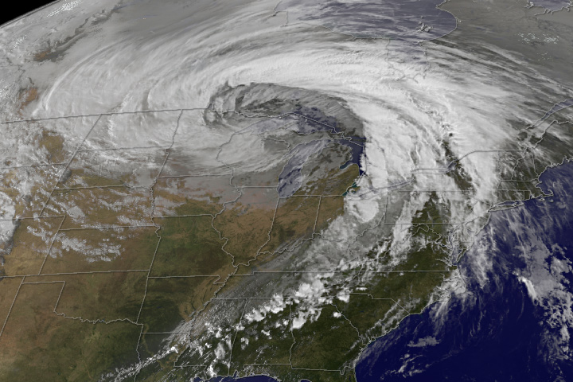
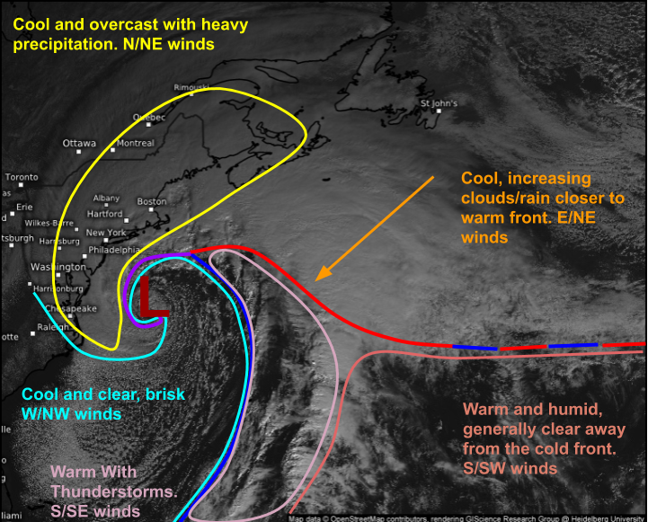
Surface Characteristics
Surface weather patterns within a mid-latitude cyclone can change quickly, depending on your location and the strength of the system.
Depending on surface temperature and moisture, a midlatitude cyclone can either strengthen or weaken!

Slide 5
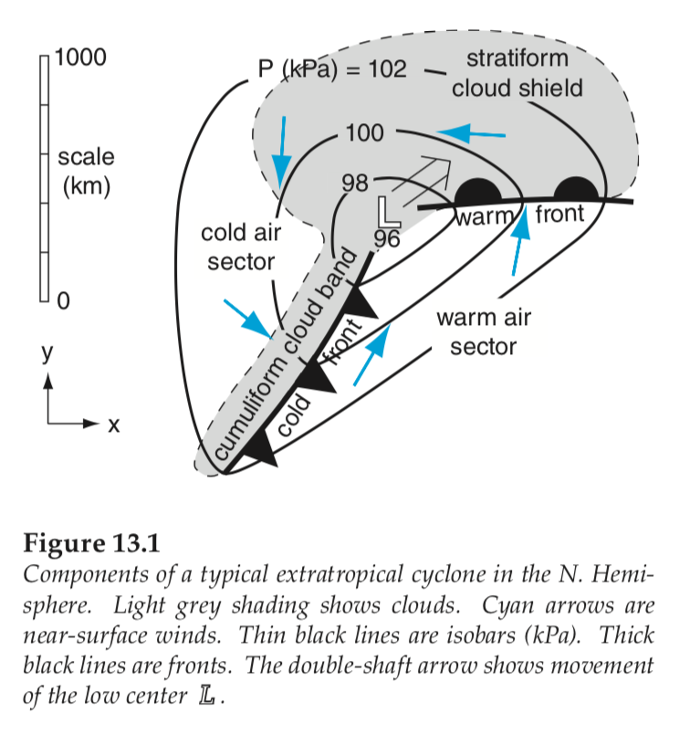
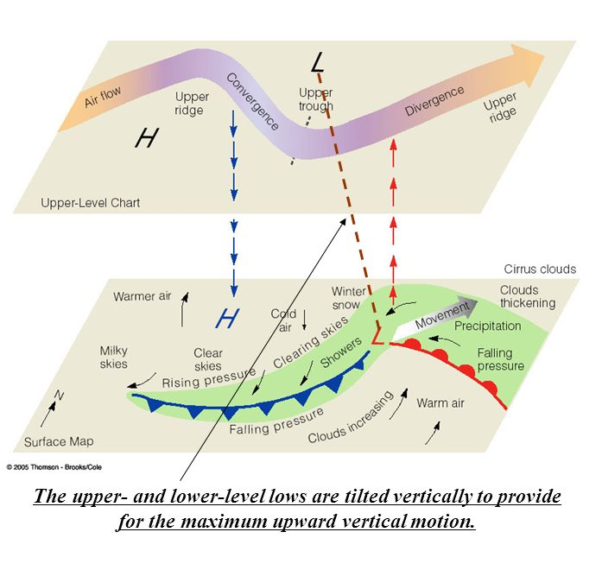
Vertical Structure
Mid-latitude cyclones have distinct (and complicated) three-dimensional structures, but the following characteristics are the most important:
Initial waves usually form around the upper-level Jet Stream.
Different vertical temperature gradients lead to different cloud and precipitation patterns along warm and cold fronts.
Wind speeds generally increase with height due to stronger pressure gradients.
Wind direction changes rapidly along frontal boundaries.

